Slide 1
Архитектуры CNN
Инна Тужикова

Slide 2
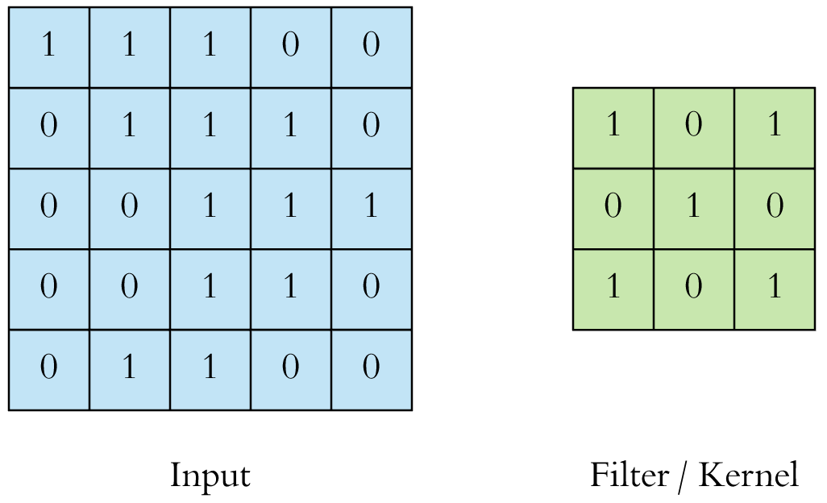
CONV

Slide 3
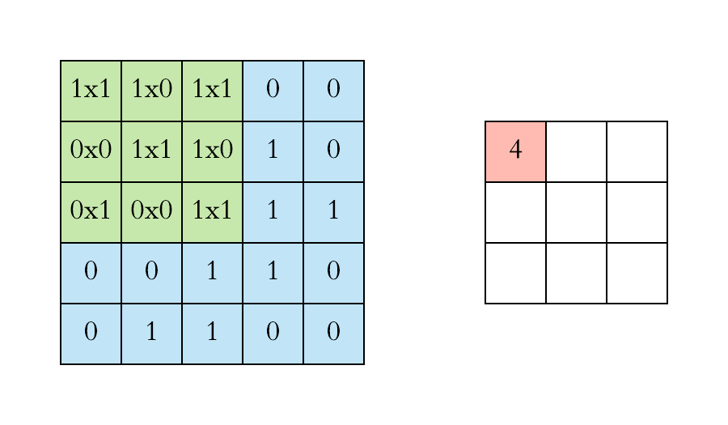
CONV

Slide 4
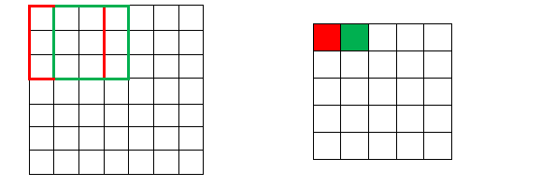
Stride

Slide 5
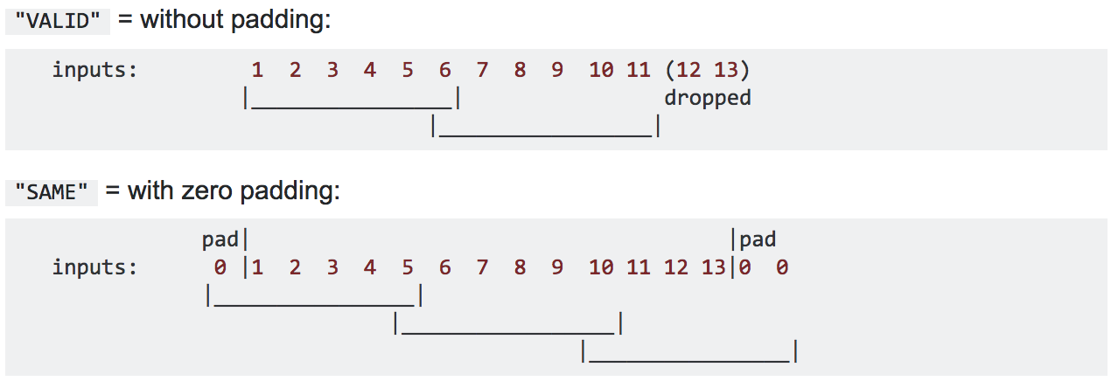
Padding
Image (13x13), kernel (6x6), stride (5x5)

Slide 6
n_conv = (n + 2p - k) / s + 1
n_conv, n - image size (w, h)
p - padding
k - kernel size
s - stride

Slide 7
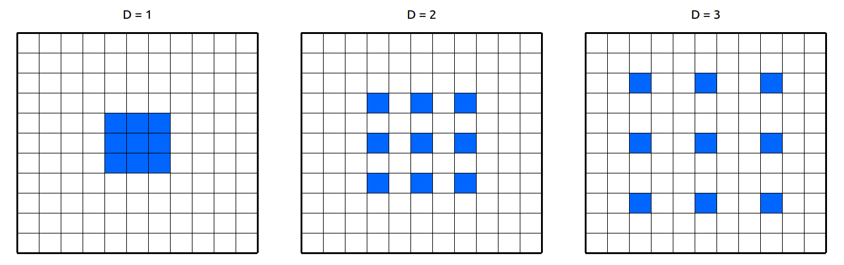
D-dilated convolution

Slide 8
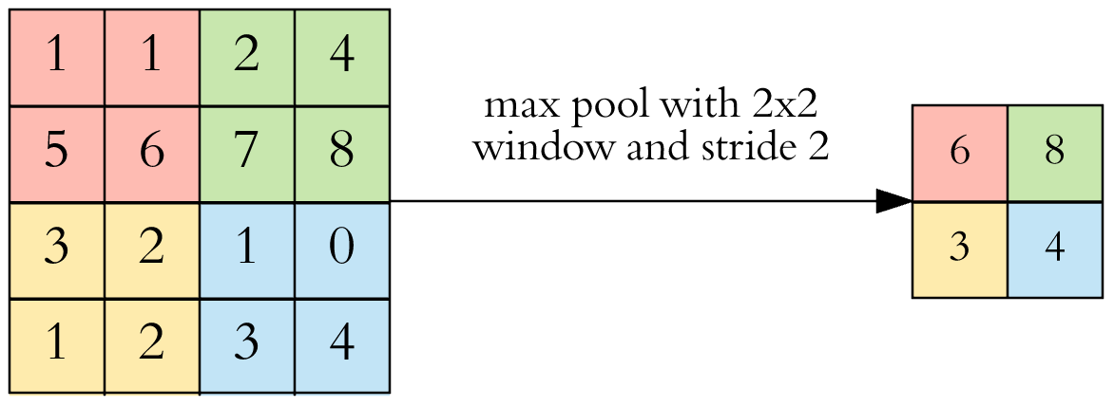
Pooling (субдискретизация)

Slide 9
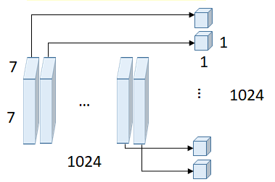
Global pooling

Slide 10
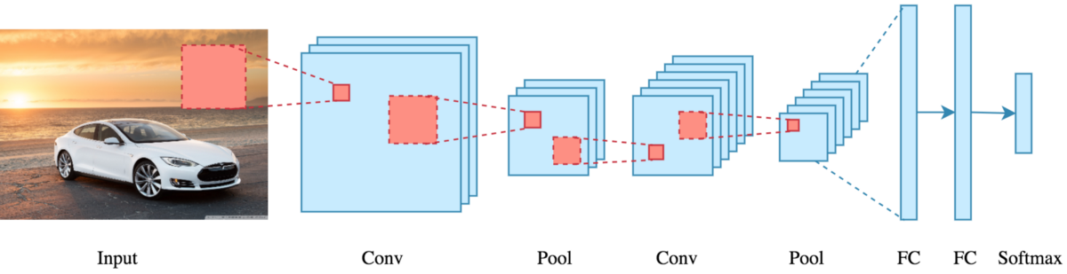
Классификатор

Slide 11
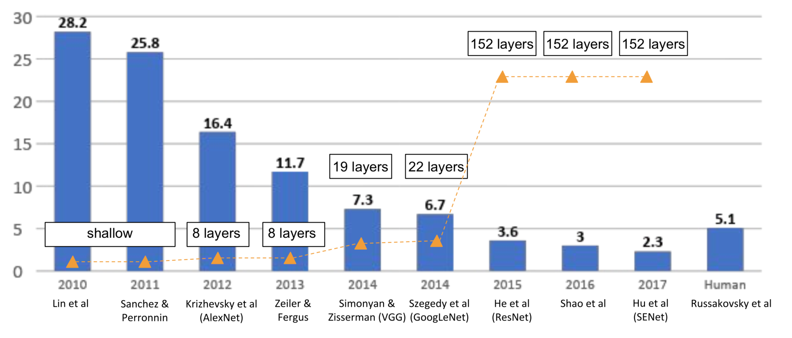
Победители ILSVRC

Slide 12
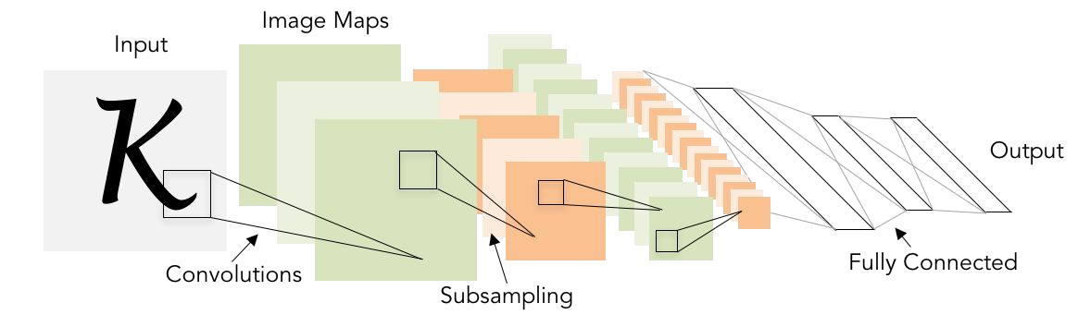
LeNet,Yann LeCunn, 1998
[CONV-POOL-CONV-POOL-FC-FC], 5x5, stride 1, 60k parameters
Hand-written numbers on checks digitized in 32x32 pixel images

Slide 13
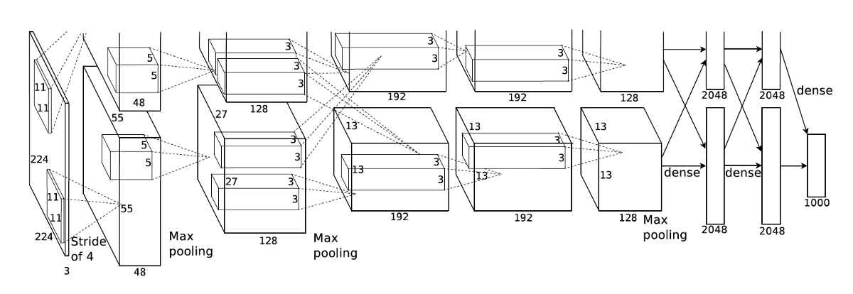
Alexnet (Krizhevsky et al.), 2012
CONV1 MAX POOL1 NORM1 CONV2 MAX POOL2 NORM2
CONV3 CONV4 CONV5 Max POOL3 FC6 FC7 FC8

Slide 14
Alexnet (Krizhevsky et al.), 2012
Input: 227x227x3
CONV1: 96 11x11 filters, stride 4
Output feature map: ?

Slide 15
Alexnet (Krizhevsky et al.), 2012
Input: 227x227x3
CONV1: 96 11x11 filters, stride 4
Output feature map: (227-11)/4+1 = 55. 55x55x96

Slide 16
Alexnet (Krizhevsky et al.), 2012
Input: 227x227x3
CONV1: 96 11x11 filters, stride 4
Output feature map: (227-11)/4+1 = 55. 55x55x96
Parameters: ?

Slide 17
Alexnet (Krizhevsky et al.), 2012
Input: 227x227x3
CONV1: 96 11x11 filters, stride 4
Output feature map: (227-11)/4+1 = 55. 55x55x96
Parameters: 11x11x3x96 ~ 35k

Slide 18
Alexnet (Krizhevsky et al.), 2012
CONV1 -> 55x55x96
POOL1: 3x3 filters, stride 2
Output feature map: ?

Slide 19
Alexnet (Krizhevsky et al.), 2012
CONV1 -> 55x55x96
POOL1: 3x3 filters, stride 2
Output feature map: (55 - 3)/2 + 1 = 27. 27x27x96

Slide 20
Alexnet (Krizhevsky et al.), 2012
CONV1 -> 55x55x96
POOL1: 3x3 filters, stride 2
Output feature map: (55 - 3)/2 + 1 = 27. 27x27x96
Parameters: ?

Slide 21
Alexnet (Krizhevsky et al.), 2012
CONV1 -> 55x55x96
POOL1: 3x3 filters, stride 2
Output feature map: (55 - 3)/2 + 1 = 27. 27x27x96
Parameters: 0

Slide 22
Alexnet (Krizhevsky et al.), 2012
62M parameters. Trained on GTX 580 GPU with only 3 GB of memory.
Network spread across 2 GPUs, half the neurons (feature maps) on each GPU.

Slide 23
Alexnet (Krizhevsky et al.), 2012
[227x227x3] INPUT
[55x55x96] CONV1: 96 11x11 filters at stride 4, pad 0
[27x27x96] MAX POOL1: 3x3 filters at stride 2
[27x27x96] NORM1: Normalization layer
[27x27x256] CONV2: 256 5x5 filters at stride 1, pad 2
[13x13x256] MAX POOL2: 3x3 filters at stride 2
[13x13x256] NORM2: Normalization layer
[13x13x384] CONV3: 384 3x3 filters at stride 1, pad 1
[13x13x384] CONV4: 384 3x3 filters at stride 1, pad 1
[13x13x256] CONV5: 256 3x3 filters at stride 1, pad 1
[6x6x256] MAX POOL3: 3x3 filters at stride 2
[4096] FC6: 4096 neurons
[4096] FC7: 4096 neurons
[1000] FC8: 1000 neurons (class scores)
- first use of ReLU
- heavy data augmentation
- dropout 0.5
- batch size 128
- SGD Momentum 0.9
- Learning rate 1e-2, x 1e-1 on val acc plateau
- 7 CNN ensemble: 18.2% -> 15.4%

Slide 25
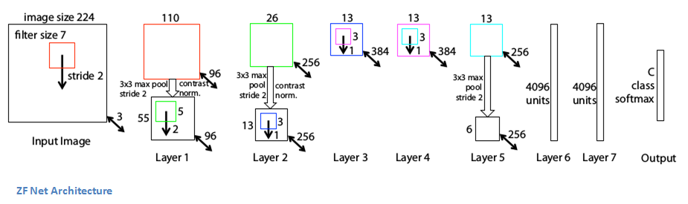
ZFNet (Zeiler & Fergus), 2013
CONV1: (11x11 stride 4) -> (7x7 stride 2)
CONV3,4,5: 384, 384, 256 filters -> 512, 1024, 512
ImageNet top 5 error: 16.4% -> 11.7%

Slide 27
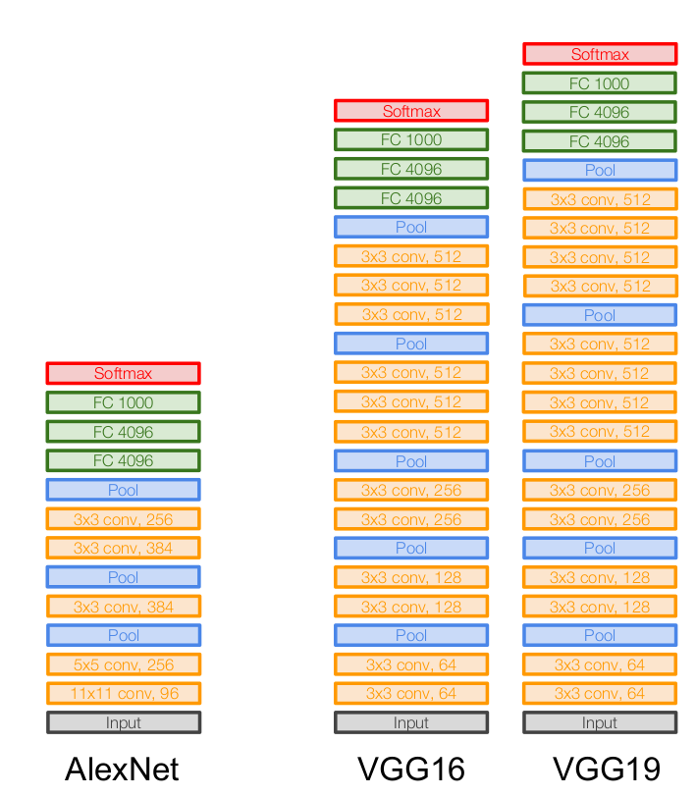
VGG (Simonyan and Zisserman), 2014
Top 5 error: 11.7% (ZFNet) -> 7.3%
3x3 CONV stride 1, pad 1
VGG16 - 138M
VGG19 - 144M

Slide 28
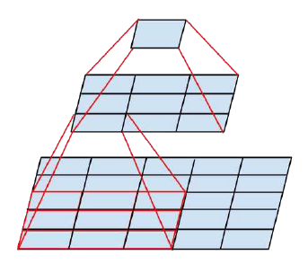
Smaller filters
Same receptive field:
(3x3) - > (3x3) and (5x5)
2 * 3*3 * C*C vs 5*5 * C*C params
(3x3) - > (3x3) - > (3x3) and (7x7)
3 * 3*3 * C*C vs 7*7 * C*C params
C = input_channels = output_channels

Slide 30
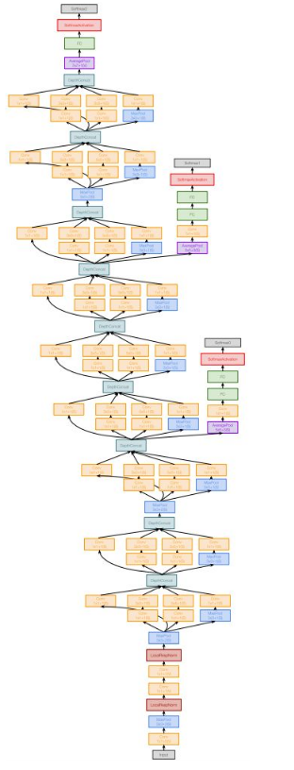
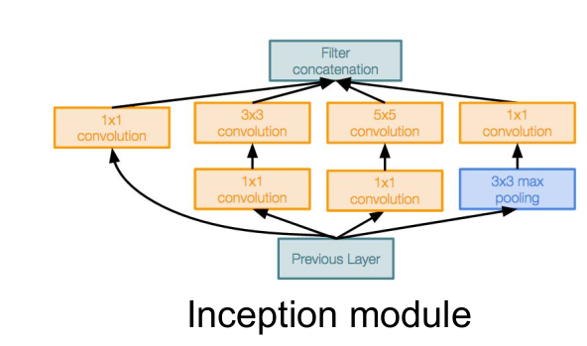
GoogLeNet / Inception v-1, (Szegedy et al.), 2014
Deeper
4M parameters
No FC
Top 5 error: 6.7%

Slide 31
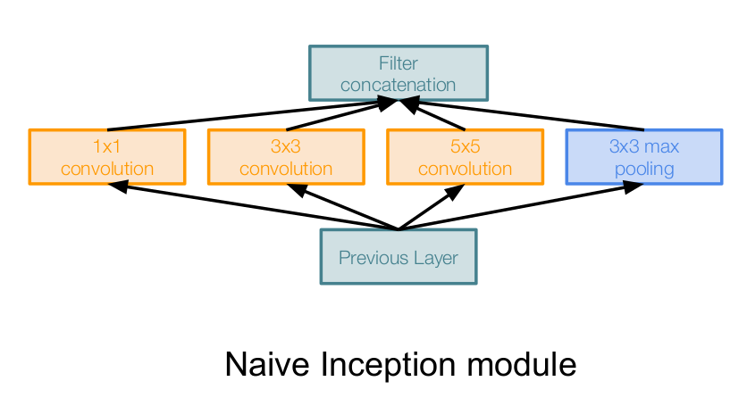
Inception module

Slide 32
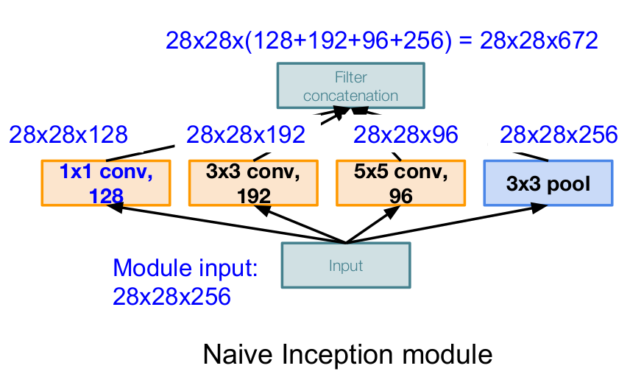
Inception module
Conv Ops:
[1x1 conv, 128] 28x28x128x1x1x256
[3x3 conv, 192] 28x28x192x3x3x256
[5x5 conv, 96] 28x28x96x5x5x256
Total: 854M ops

Slide 33
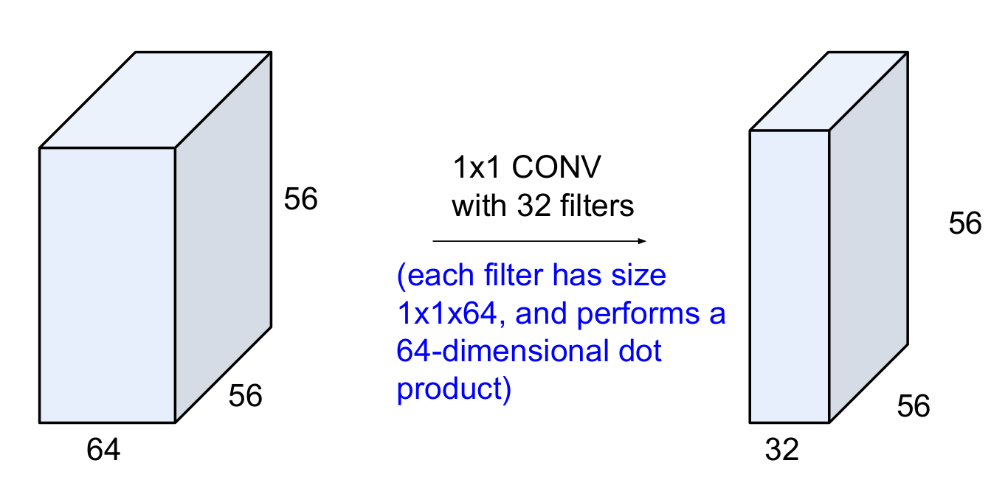
Conv 1x1

Slide 34
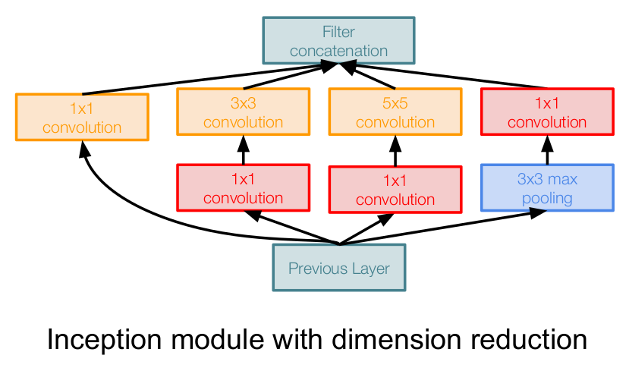
Inception module

Slide 35
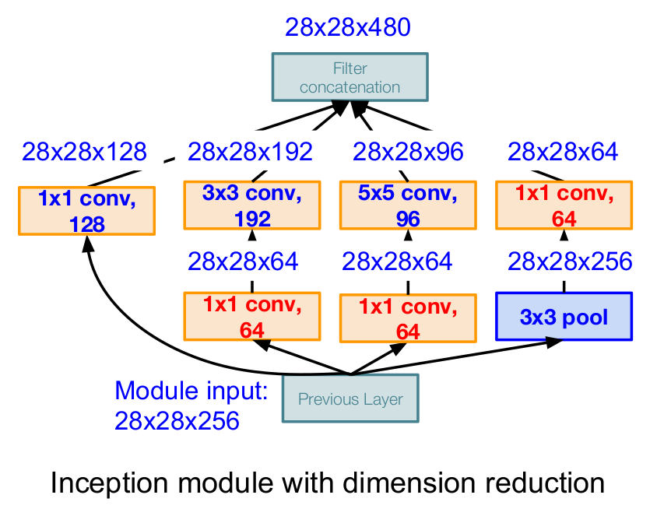
Inception module
Conv Ops:
[1x1 conv, 64] 28x28x64x1x1x256
[1x1 conv, 64] 28x28x64x1x1x256
[1x1 conv, 128] 28x28x128x1x1x256
[3x3 conv, 192] 28x28x192x3x3x64
[5x5 conv, 96] 28x28x96x5x5x64
[1x1 conv, 64] 28x28x64x1x1x256
Total: 358M ops

Slide 36
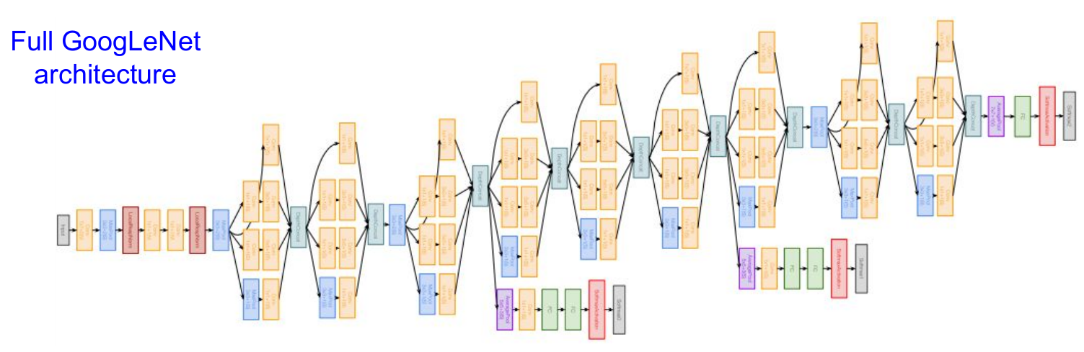

Slide 37
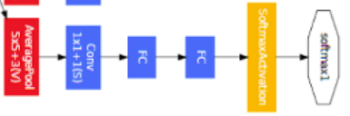
Auxiliary classification outputs
Avg pool 5x5, stride 3
Conv 1 × 1, 128
FC 1024
FC 1000
Softmax
Train: 0.3
Inference: no

Slide 38
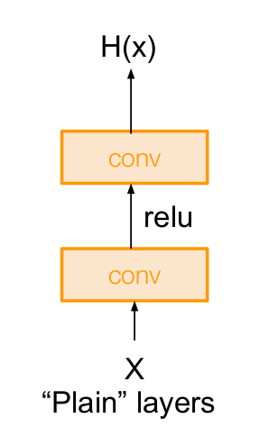
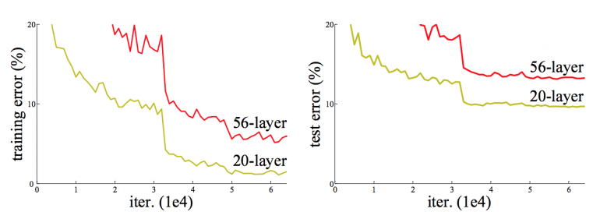
Plain CNN + stacking layers, (He et al., 2015)
Not overfitting

Slide 39
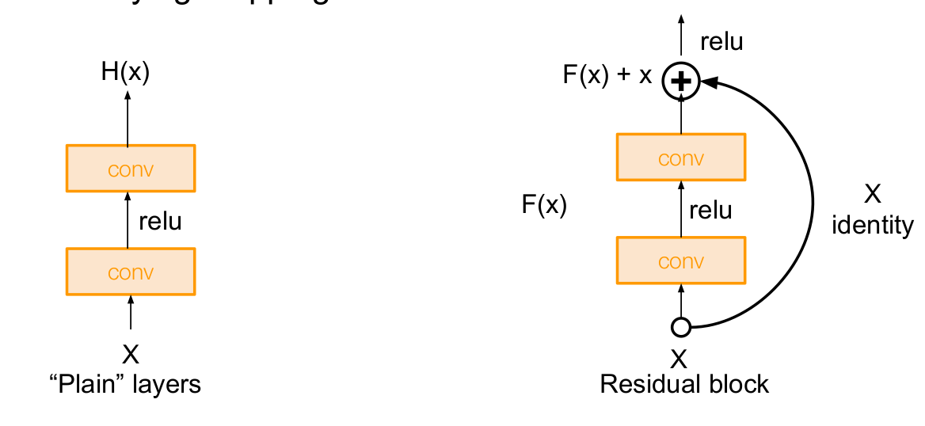
ResNet, Microsoft, (He et al.), 2015

Slide 40
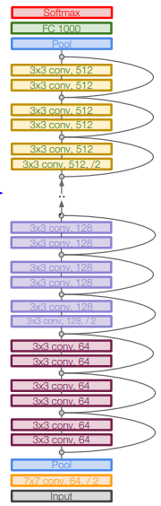
ResNet
Top-5 error: 6.7% -> 3.57%
stack residual blocks
2 3x3 conv layers
double # of filters, downsample, stride 2 (/2)
conv layer at the beginning
no FC at the end (only FC 1000)
34, 50, 101, or 152 layers (ImageNet)

Slide 41
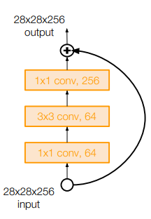
ResNet-50+
Bottleneck layer to improve efficiency
(similar to GoogLeNet)

Slide 42
ResNet train
Batch Normalization after every CONV layer
Xavier/2 initialization from He et al.
SGD + Momentum (0.9)
lr=1e-1, x1e-1 on val error plateau
batch size 256
no dropout used

Slide 43
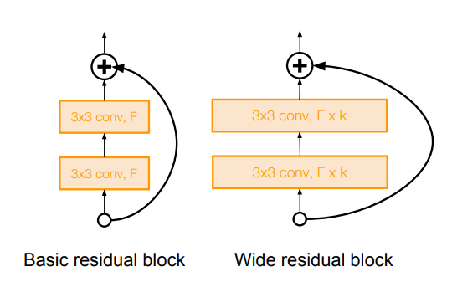
Wide Residual Networks (Zagoruyko et al.), 2016
Wider residual blocks
F x k filters instead of F filters
50-layer wide ResNet outperforms 152-layer original ResNet
Increasing width instead of depth more computationally efficient (parallelizable)

Slide 44
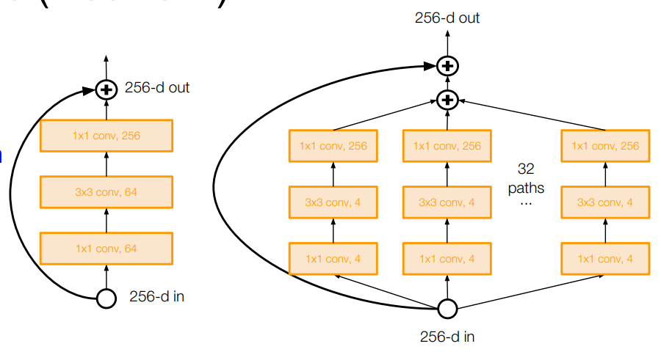
ResNeXt (Xie et al.), 2016

Slide 45
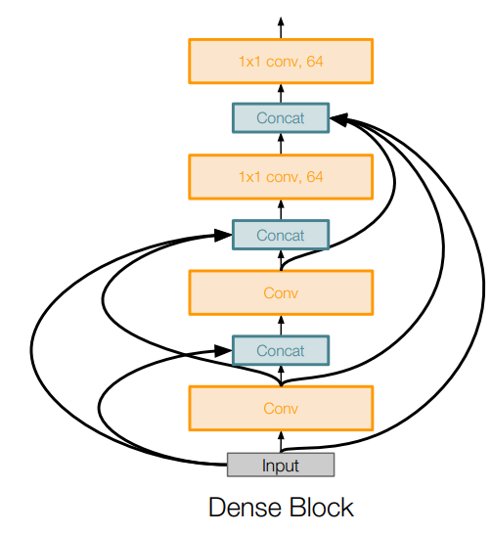
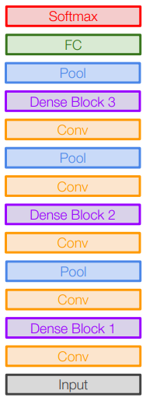
Densely Connected CNN, (Huang et al.), 2017
Each layer is connected to every other layer in feedforward fashion
Alleviates vanishing gradient
Encourages feature reuse

Slide 46
ResNet + stochastic depth
Inception v4 (+ residual blocks)
SENet (Squeeze-and-Excitation, 2017 winner)
FractalNet
NiN (Network in Network)
MobileNet
...

